Slide 1
Code Optimization
Md. Neamul Haque
Lecturer,CSE,Premier University

Slide 2
Code Optimization
High-level language constructs can introduce substantial run-time overhead if we naively translate each construct independently into machine code.
Elimination of unnecessary instructions in object code, or the replacement of one sequence of instructions by a faster sequence of instructions that does the same thing is usually called "code improvement" or "code optimization."

Slide 3
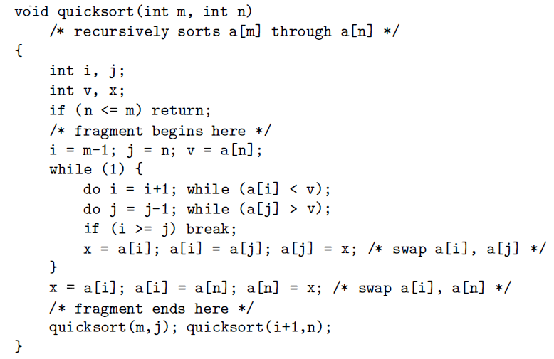
Quicksort

Slide 4
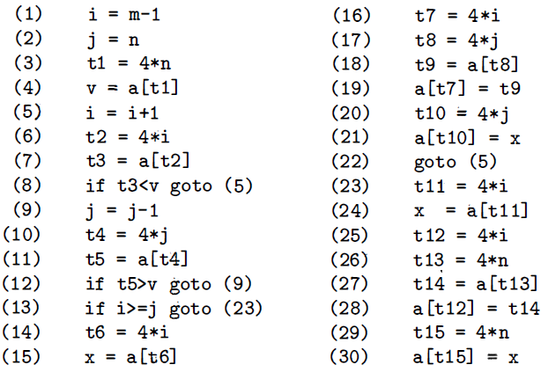
Integers = 04 bytes

Slide 5
B₁
B₅
B₂
B₃
B₆
B₄

Slide 6
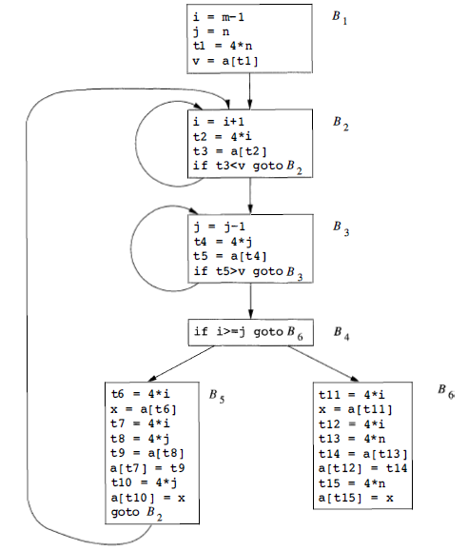
Flow Graph

Slide 7
Optimization Techniques: Semantic Preserving Transformations
Common-sub expression elimination
Copy Propagation
Dead-code elimination
Constant folding

Slide 8
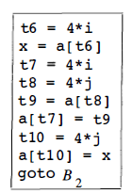
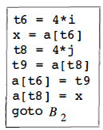
Local Common Sub-expression Elimination
Before
A program will include several calculations of the same value, such as an offset in an array.
Some of these duplicate calculations cannot be avoided by the programmer because they lie below the level of detail accessible within the source language.
B5 recalculates 4*i & 4*j, although none of these calculations were requested explicitly by the programmer.
After

Slide 9
GLOBAL Common Sub-expression Elimination
An occurrence of an expression E is called a common sub-expression if E was previously computed & the values of the variables in E have not changed since the previous computation
We avoid recomputing E if we can use its previously computed value;
variable x to which the previous computation of E was assigned has not changed in the interim.

Slide 10
Example 9.2: Fig. shows the result of eliminating both global and local common sub expressions from blocks B5 and B6 in the flow graph.

Slide 11
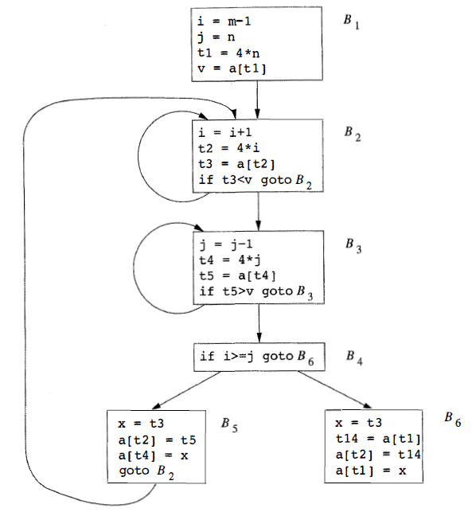

Slide 12
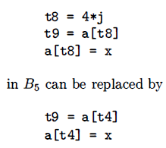
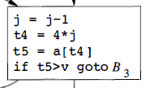
After local common sub expressions are eliminated, B₅ still evaluates 4*i & 4*j.
Both are common subexpressions; in particular, the three statements
B₅
B₃
using t₄ computed in block B₃ .
Observe that as control passes from the evaluation of 4*j in B₃ to B₅, there is no change to j & no change to t₄, so t₄ can be used if 4*j is needed.

Slide 13
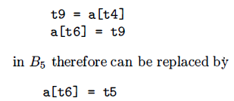
Another common sub expression comes to light in B₅ after t₄ replaces t₈
The new expression a[t₄] corresponds to the value of a[ j] at the source level.
Not only does j retain its value as control leaves B₃ & then enters B₅ , but a[j] , a value computed into a temporary t₅, does too, because there are no assignments to elements of the array a in the interim.
The statements
B₅
B₃

Slide 14
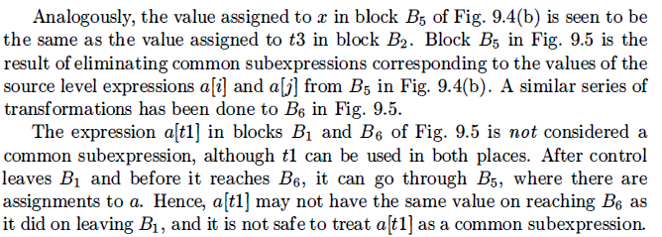
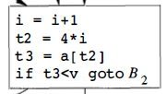
B₅
B₂

Slide 15


Slide 16
Copy Propagation
Block B₅ can be further improved by eliminating x using two new transformations.
One concerns assignments of the form u = v called copy statements.

Slide 17
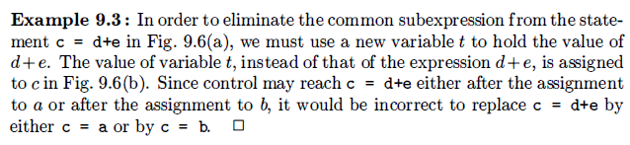
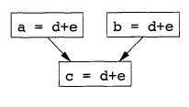
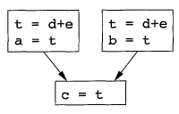
(a)
(b)

Slide 18
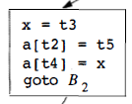
The idea behind the copy-propagation transformation is to use v for u, wherever possible after the copy statement u=v.
assignment
x = t₃ in block B₅ is a copy.
B₅

Slide 19
Dead Code Elimination
A variable is live at a point in a program if its value can be used subsequently; otherwise, it is dead at that point.
A related idea is dead (or useless) code statements that compute values that never get used.
While the programmer is unlikely to introduce any dead code intentionally, it may appear as the result of previous transformations.

Slide 20
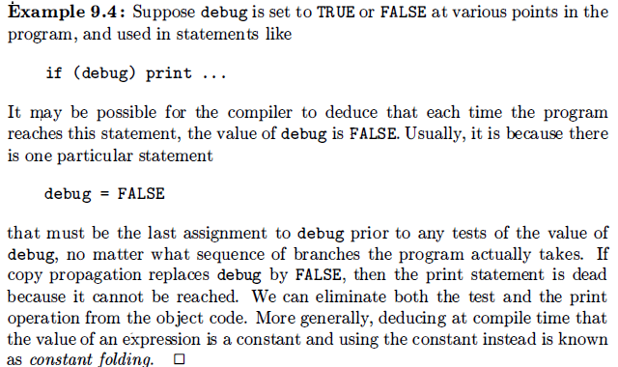

Slide 21

One advantage of copy propagation is that it often turns copy statement into dead code.
Copy propagation followed by dead-code elimination removes the assignment to x and transforms the code

Slide 22
Problems
Page 51: 2.2.1, 2.2.2
Page 125: 3.3.2,
Page 151: 3.6.3
Page 166: 3.7.3
Page 206: 4.2.1, 4.2.2
Page 216: 4.3.1
Page 370: 6.2.1
Page 440: 7.2.3
Page 516: 8.2.1, 8.2.2, 8.2.6
Page 531: 8.4.1

